Slide 1
HDS Training – Drug Cohort
6 November 2026

Slide 2
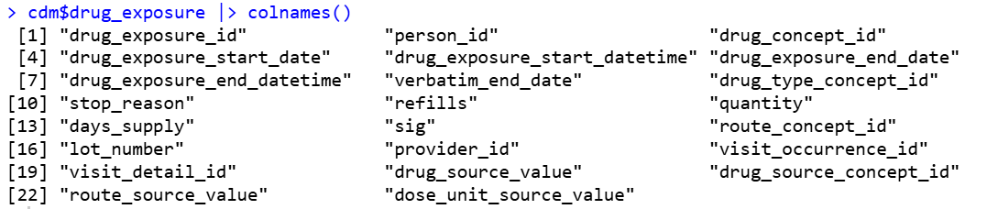
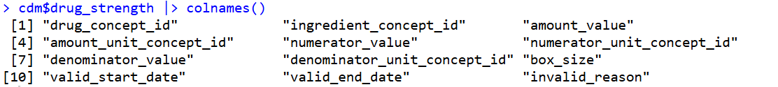
Structure of a drug record in OMOP CDM
Who
What drug
How long
When
Type of record
Dose (together with drug_strength)

Slide 3
Outline
Identifying drug of interest
  ATC/ingredient
  Drug form/route/brand
Drug treatment duration
  How to calculate
  Gap era
Drug type
  … and its healthcare settings
Dose
  DDD

Slide 4
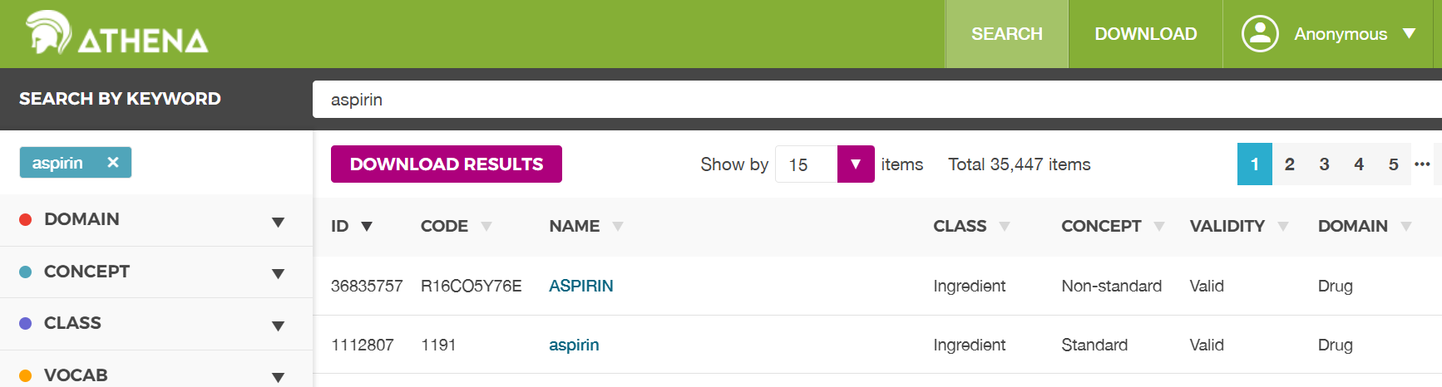
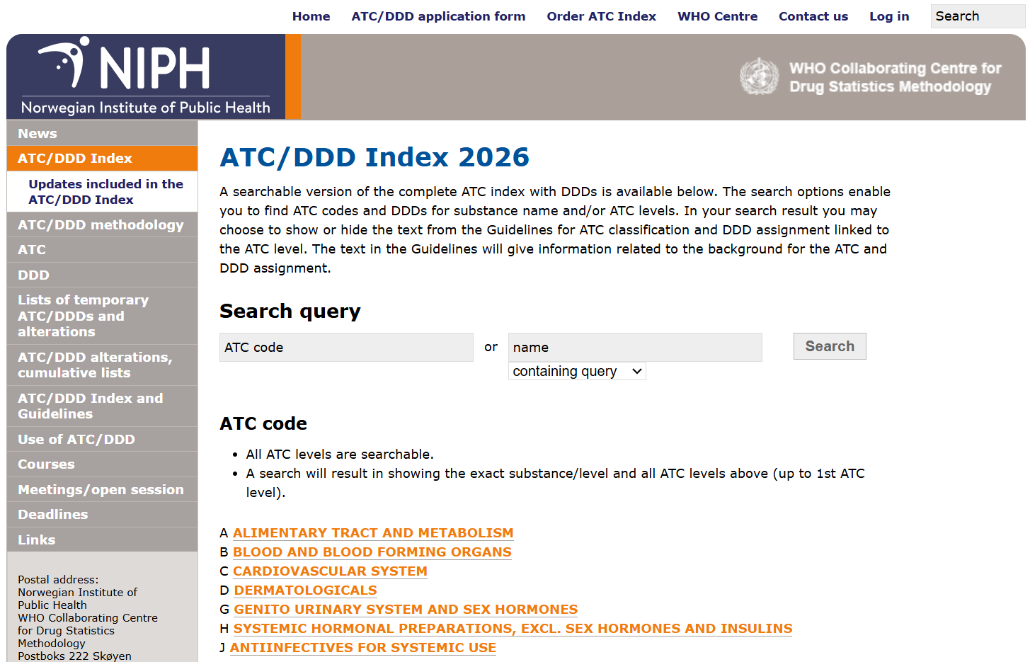
Identifying drug of interest
By ingredient
By drug class → ATC code

Slide 5
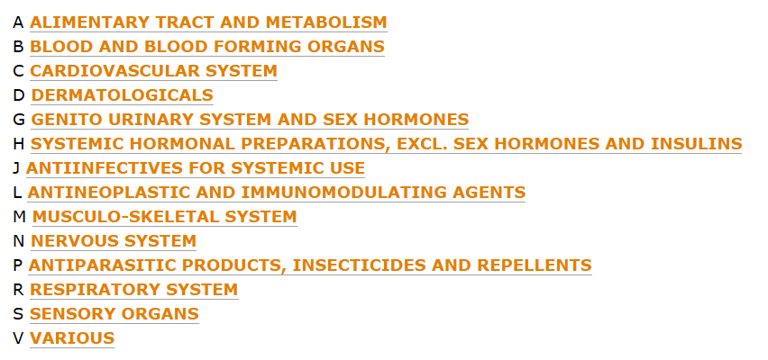
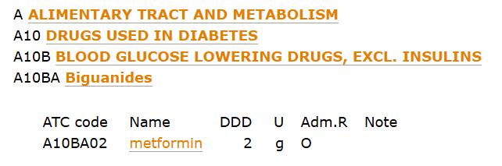
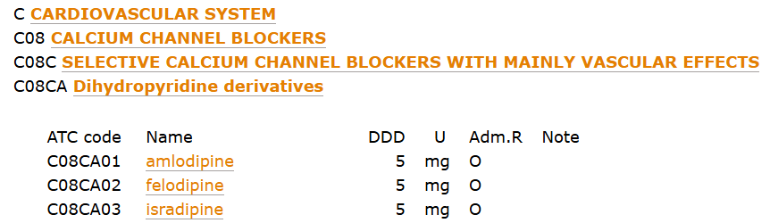
What is ATC code
WHO Anatomical Therapeutic Chemical classification
Comes with 5 levels
  1st : Anatomical/pharmacological group
  2nd: Pharmacological/therapeutic group
  3rd/4th: Chemical/pharmacological/therapeutical
  5th: Chemical structure/substance

Slide 6
Consideration when using ATC codes
Unrelated ingredient from other therapeutic class
Not capturing all ingredients for a particular therapeutic purpose
One drug class into different ATC codes
ATC codes update over time (tho not too frequent/common)

Slide 7
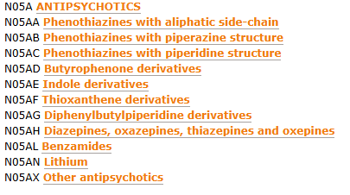
Unrelated ingredients
Might include some other ingredients that you don’t want
Example: antipsychotics
  Lithium is mood stabiliser but not considered as antipsychotics in clinical practice

Slide 8

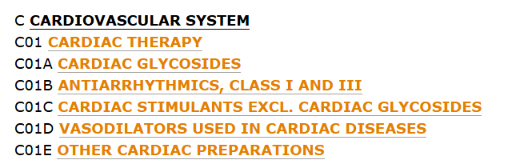
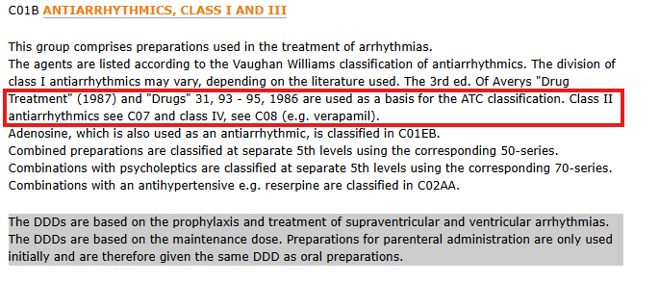
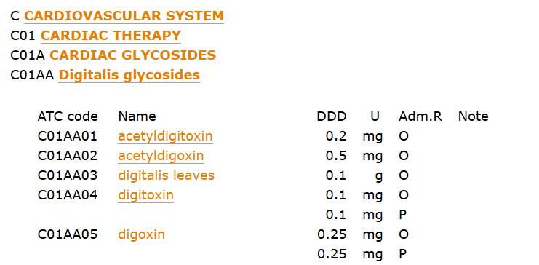
Not capturing all ingredients for a therapeutic purpose
Not necessarily include all related ingredient if you think therapeutically
Example: antiarrhythmic drug
Pharmacological class

Slide 9
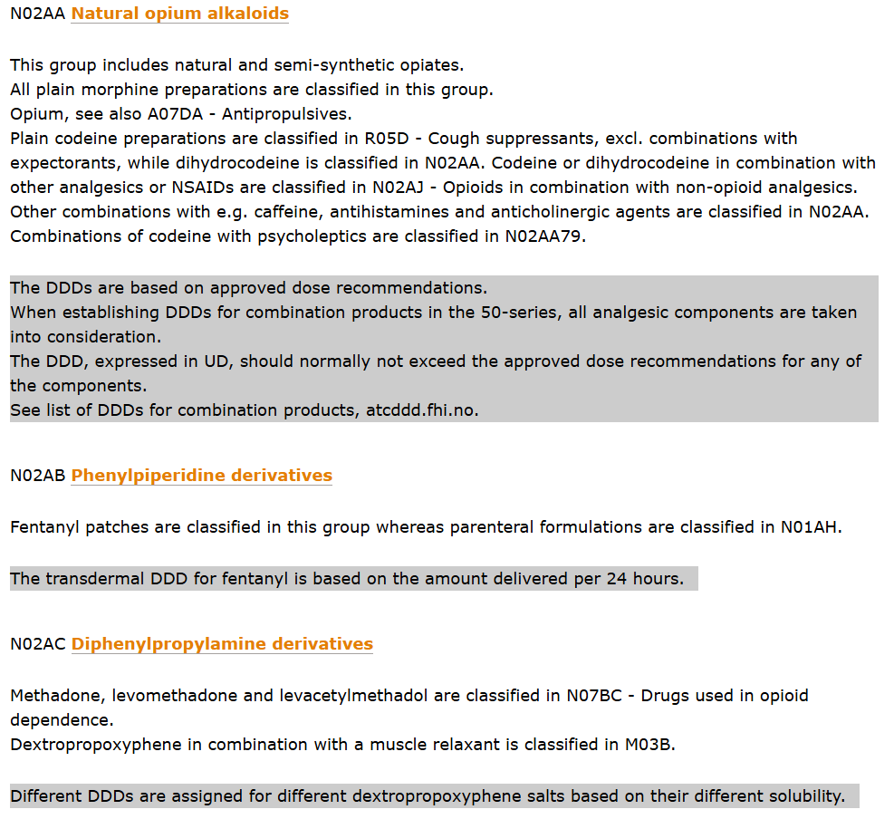
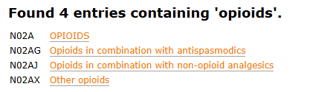
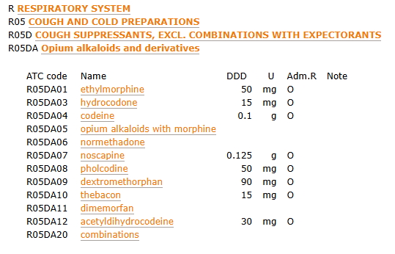
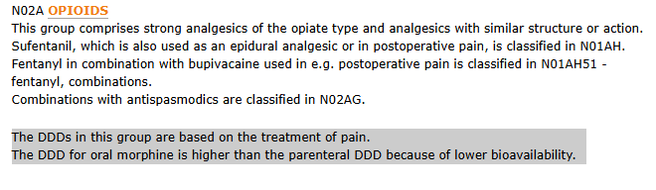
One drug class into different ATC codes
One pharmacological drug class can be separated into different ATC codes for different therapeutic reason
Examples: opioids

Slide 10
ATC code update over time
ATC code would update over time (with new drug class)
Example: COVID-19 vaccine
(J07BX other viral vaccines to J07BN COVID-19 vaccines)

Slide 11
ATC code is intuitive to use, but mapping from ATC to concept ID is tricky
From vocabulary level
  Can be preparation specific (e.g. formulation or combination for different therapeutic purpose), but not always the case
  Even the ATC included the drug of interest, it does not necessarily include all the descendent of that drug
From source data level
  Granularity of data mapping
getATCCodes vs getDrugIngredientCodes

Slide 12
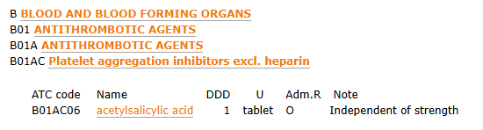
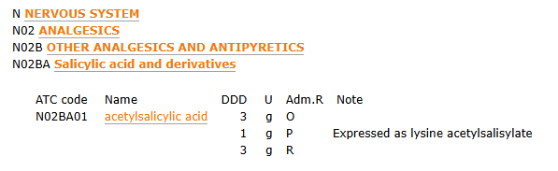
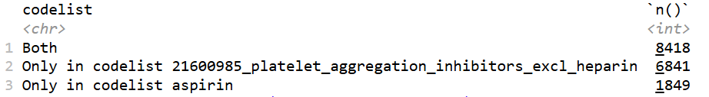
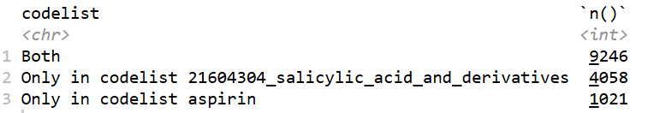
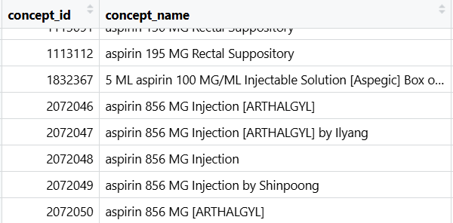
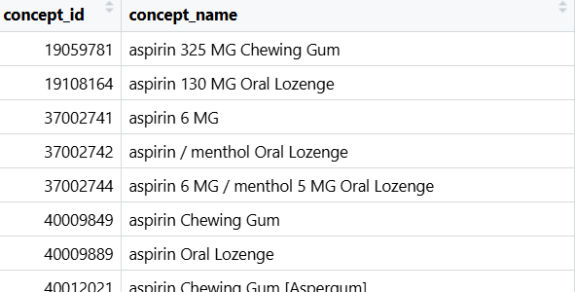
Example: aspirin as antiplatelet/analgesics
Only in ‘only aspirin’ here but not in the other (i.e. included in analgesic but not platelet aggregation inh):
Injectable/rectal/random
Only in ‘only aspirin’ here but not in the other (i.e. included in platelet aggregation inh but not in analgesic):
Lozenges/gum/sublingual
** still a lot of relevant code in the aspirin only codelist

Slide 13
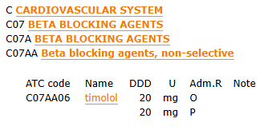
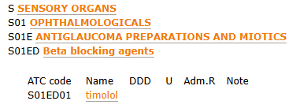
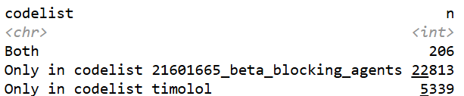
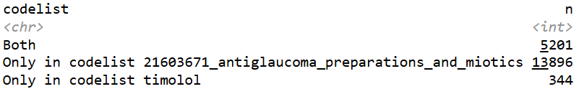
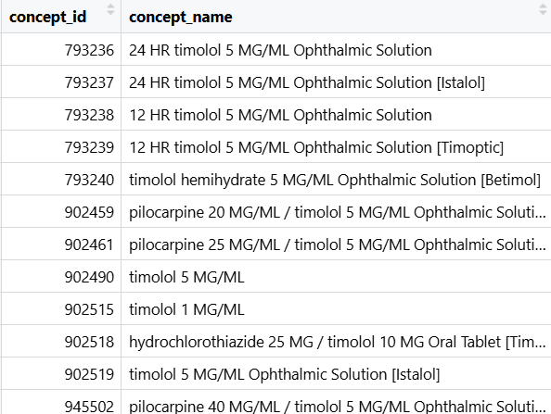
Example: timolol as oral/topical
Most are eye-drops, but there are still some timolol combination drug for CV indication
ATC mapping seems to be preparation specific??

Slide 14
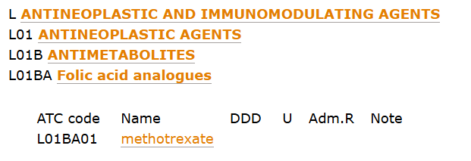
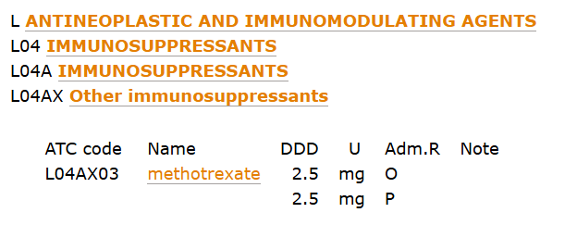
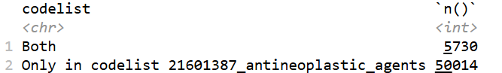

Example: antineoplastic agents/methotrexate
Behaviour of ATC mapping seems to be a bit unpredictable…

Slide 15
Summary: ATC class
ATC is intuitive and easy to use
Review ingredient after creating codelist
To generate codelist: getATCCodes vs getDrugIngredientCodes
  ATC -> ingredient -> getDrugIngredient
  ATC -> ingredient -> (check and exclude those unwanted ingredient)
  Depend on research question/how you are using the drug codelist
PhenotypeR: codelist diagnostics

Slide 16
Drug concept
Understand the OMOP CDM drug concept
  Ingredient
  Component
  Form
  Brand
Example:
43278649 Acetaminophen 100 MG/ML Oral Solution [Paracetamol Infant]
Ingredient | Ingredient | Ingredient | Ingredient
 | Component |  | Component
 |  | Form | Form
Ingredient | Clinical/branded drug component | Clinical/branded drug form | Clinical/branded drug
Notes:
Ingredient
= ingredient
Ingredient+Component
= strength information
Ingredient+Form
= dose form information
Ingredient+Component+Form
= clinical drug level
.. + Brand
= Branded Drug/Component/Form

Slide 17
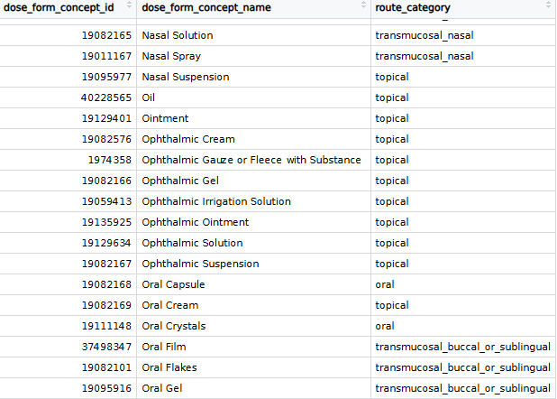
Dose form and route
availableDoseForms(cdm)
doseFormToRoute
availableRouteCategories(cdm)
**Information comes from concept

Slide 18
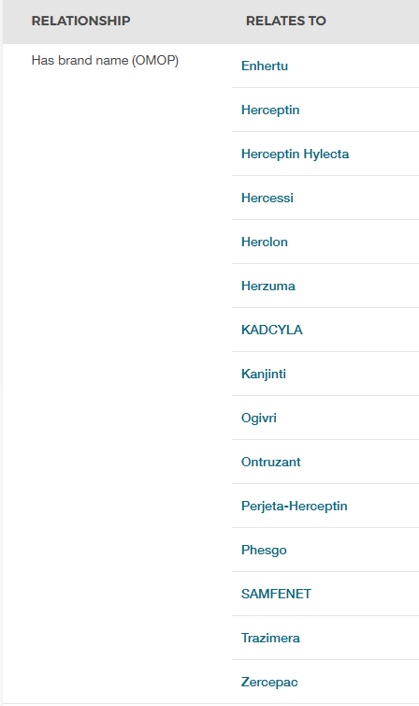
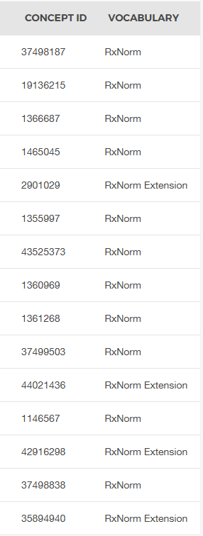
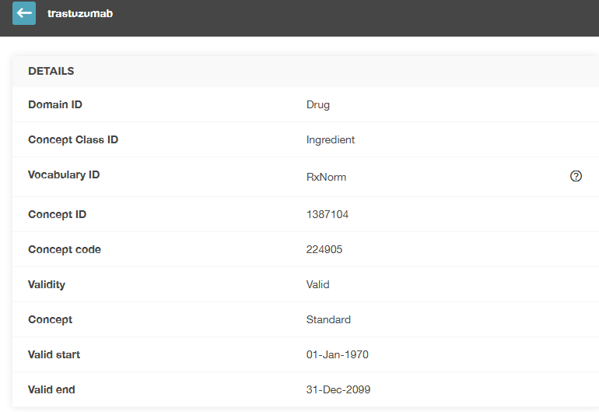
Brand

Slide 19
Summary: route/dose form/brand
Use information from concept on route/dose form/brand with current packages
Codelist generator to create drug cohort based on these
** granularity of drug data mapping
** route stratification not based on the drug_exposure$route_concept_id

Slide 20
Type of drug records
… and their healthcare settings
GP/specialist
Hospital outpatient/specialist
Hospital inpatient
Hospital discharge
Pharmacy records
Prescription
Dispensation
Administration
Registry
Can be checked from DED within PhenotypeR
Prescription record
Dispensation record
** check with DP if they have overlapping (prescription/dispensation)
Prescription record
Dispensation record

Slide 21
Drug treatment duration
There could be assumption around how they define drug exposure end date
Examples: default assumption of 30 days/1 day
Examples: derived from DDD

Slide 22
Exposure -> Era: gap era
Difference ≤ defined gap era
Drug exposure
Drug exposure
Drug era
Assumption on whether the drug is discontinued or just temporary interruption
Depends on nature of treatment (short, intermittent, chronic, or episodic)
Notes:
PMID: 19880282
** 90-day gap era for long term treatment is not a hard rule

Slide 23
Concatenation by ingredient vs by class
By ingredient
By class
Drug A
Drug A
Drug A
Drug B
Drug A
Drug B
Drug B
Drug B
Collapse
Collapse
Drug A era
Drug A era
Drug era
Drug B era
Drug B era
Union
Drug era
Drug era
Drug era
Drug era
Notes:
** 90-day gap era for long term treatment is not a hard rule

Slide 24
Dose
Calculated from: start date/end date/quantity/drug strength table
Don’t ask about dose cohort creation (yet?)
Dose cohort workaround: review codelist, manually define based on concept (still limited by unknown dosage)
Honourable mention: Defined daily dose (DDD)
  Defined by WHO
  Assumed average maintenance dose per day for a drug for main indication
  By ingredient, by route of administration/preparation (by indication)
  For standardisation purpose

Slide 25
Summary: drug type/duration/dose
Check drug type/duration/dose in DED (now within phenotypeR) and make appropriate selection/adjustment
Be careful with the assumption made during the mapping process (especially duration and dose)

Slide 26
Coding time!

